Slide 1
Statistics

Slide 2
Statistics
It is a branch of applied Mathematics which deals with
Data collection
Data Analysis
Data Interpretation
Data Presentation
Statistics is concerned with summarizing, describing and characterize the sample being studied on the data.

Slide 3
Statistics
Descriptive Statistics
Inferential
Statistics

Slide 4
Inferential statistics
It makes predictions about a population based on a sample of data taken from the population and draws conclusions from the data that are subject to random variation

Slide 5
Descriptive statistics
Descriptive statistics is a branch of Statistics.
Its aim is to summarize a set of statistical data.
It is an essential element in any improvement process.
It uses analytical methods which provide the math to model and predict variation.
It uses graphical method to help making numbers visible for communication purposes.

Slide 6
Descriptive statistics:
Helps in exploring and making conclusions about the data in order to make rational decisions.
Includes calculating things such as the average of the data , its spread and the shape it produces.
Useful because they allow you to make sense of the data.

Slide 7
Descriptive statistics
For example:
A college involve the average math test score for incoming students. It says nothing about why the data is so or what trends we can see and follow.
Descriptive statistics help you to simplify large amounts of data in a meaningful way. It reduces lots of data into a summary.

Slide 8
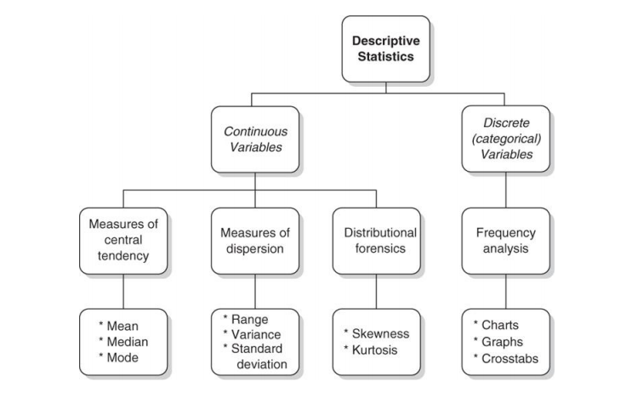
Descriptive statistics:

Slide 9
Descriptive statistics:
Descriptive statistics has 2 main types
Measures of Central Tendency (Mean(AM,GM,HM), Median, and Mode).
Measures of Dispersion or Variation (Variance, Standard Deviation, Range).

Slide 10
Measure of central tendency:
A measure of central tendency is a single value that describes the way in which a group of data cluster around a central value.
To put in other words, it is a way to describe the center of a data set.
There are three measures of central tendency: mean, median, and mode.

Slide 11
Measure of central tendency:
It lets us know what is normal or 'average' for a set of data.
It also condenses the data set down to one representative value, which is useful when you are working with large amounts of data.

Slide 12
Measure of central tendency:
Central tendency also allows you to compare one data set to another.
Measures of central tendency help you find the middle, or the average, of a data set.

Slide 13
Measure of central tendency:
For example, let's say you have a sample of girls and a sample of boys, and you are interested in comparing their heights. By calculating the average height for each sample, you could easily draw comparisons between the girls and boys.

Slide 14
Descriptive statistics
A collection of objects in a specified pattern in mathematics is called a “Mathematical Sequence” – also called as “Progression”.
It includes 3 types of sequences:
Arithmetic Mean
Geometric Mean
Harmonic Mean

Slide 15
Descriptive statistics
Arithmetic Mean:
The total of all the values divided by the size of the data set.
It is the most commonly used statistic of position.
It is easy to understand and calculate.

Slide 16
Descriptive statistics
Arithmetic Mean:
It works well when the distribution is symmetric and there are no outliers.
The mean of a sample is denoted by ‘x-bar’.
The mean of a population is denoted by ‘µ’.

Slide 17
Descriptive statistics
Arithmetic Mean:
The arithmetic mean is the average of a series of numbers.
The formula for calculating the arithmetic mean is:
Arithmetic mean = (X 1+ X2 + X3 + ... +XN) / N
where X1, X2, X3, XN are the values of the observations being averaged and N equals the number of observations

Slide 18

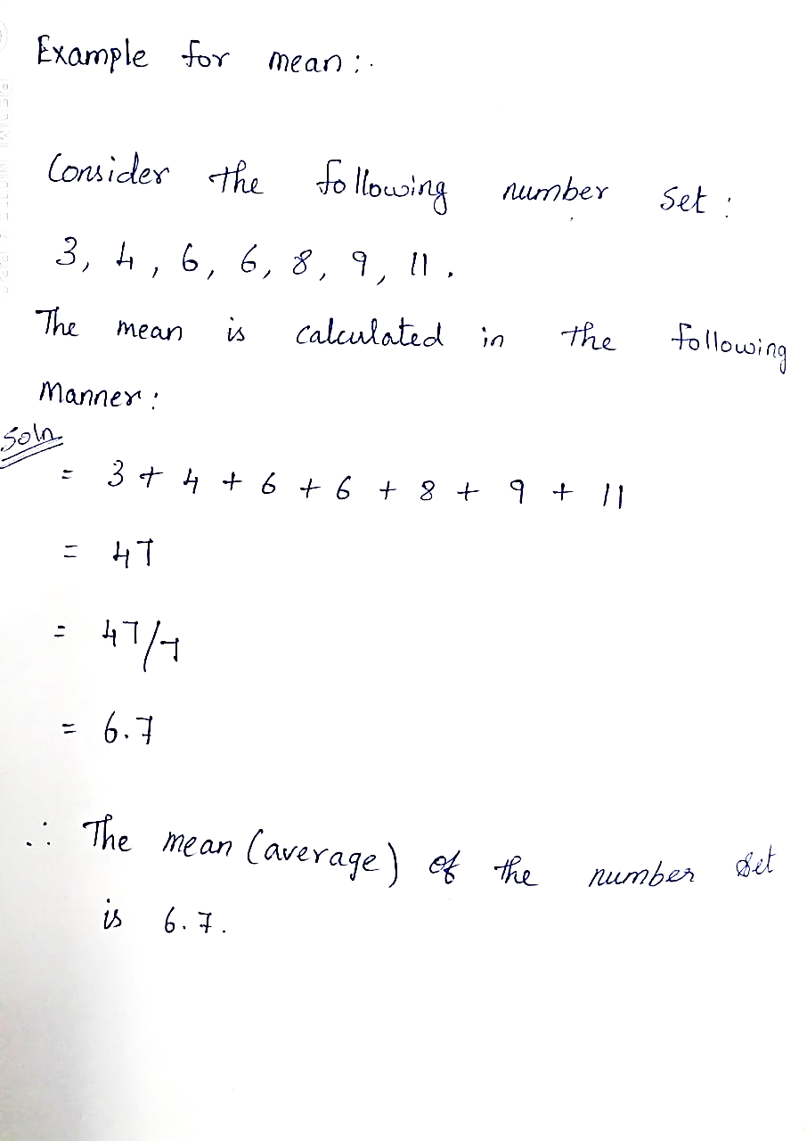
Example for mean:

Slide 19
Geometric mean:
In mathematics, the geometric mean is a mean or average, which indicates the central tendency or typical value of a set of numbers by using the product of their values (as opposed to the arithmetic mean which uses their sum).

Slide 20
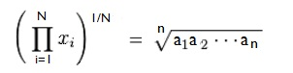
Geometric mean:
The geometric mean is defined as the nth root of the product of n numbers, i.e., for a set of numbers x1, x2, ..., xn, the geometric mean is defined as
The geometric mean applies only to positive numbers.

Slide 21
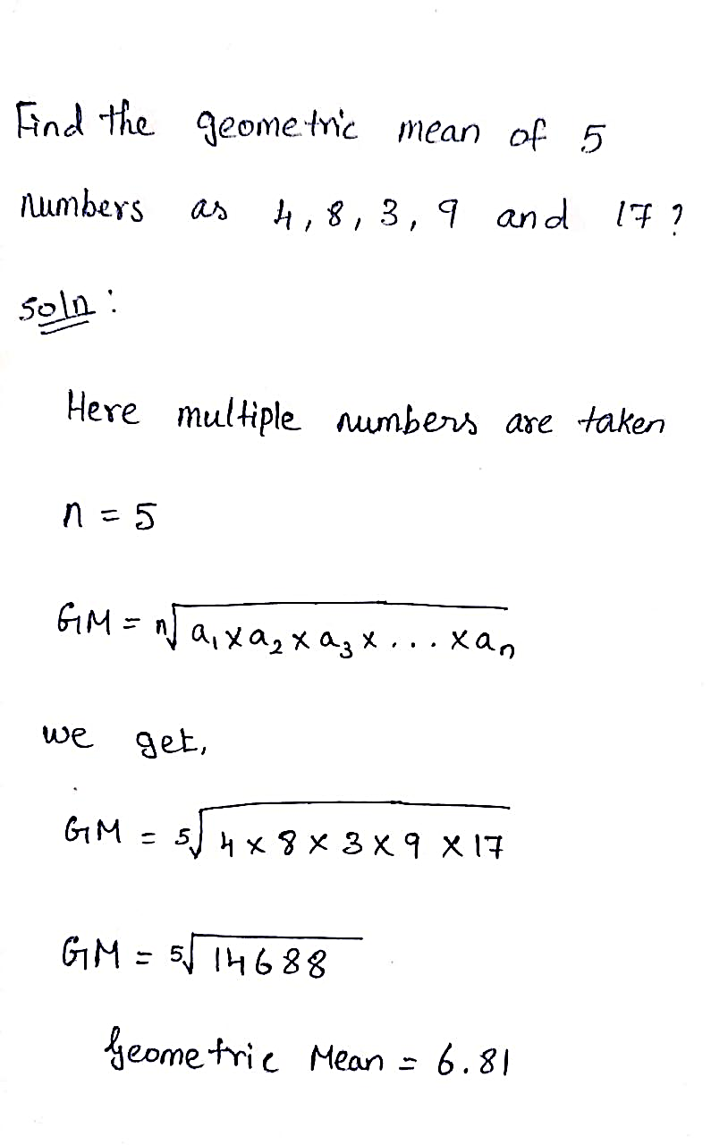
Geometric mean:

Slide 22
Harmonic mean:
What is Harmonic Mean?
Harmonic means are terms that are between any two non-consecutive terms of a harmonic sequences.

Slide 23
Harmonic mean:
What is Harmonic Mean?
When three numbers are in H.P(Harmonic Progression) the middle number is called the harmonic mean between the other two numbers.

Slide 24
Harmonic mean:
What is Harmonic Mean?
There is no general formula for the sum of any number of terms in HP.
Harmonic Mean is the reciprocal of the arithmetic mean of the reciprocals, the formula to define the harmonic mean “H” is given as follows:

Slide 25
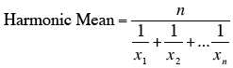
Harmonic mean:
What is Harmonic Mean?
The harmonic mean has the least value compared to the geometric and arithmetic mean: min<HM<GM<AM<max

Slide 26
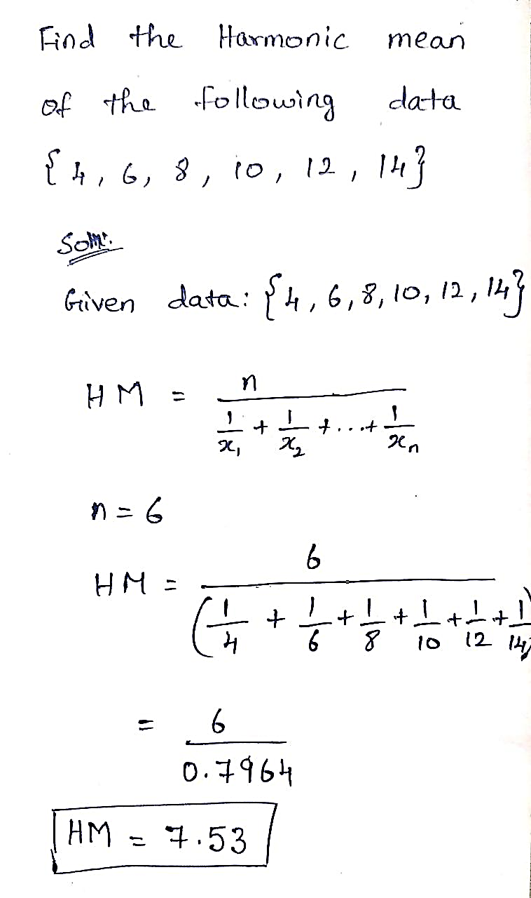
Harmonic mean:

Slide 27
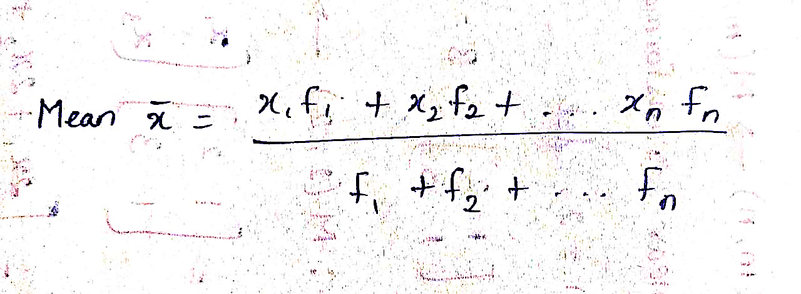
mean: Numericals
Determine the mean value for the following distribution
x | 2 | 4 | 6 | 8 | 10
f | 5 | 10 | 15 | 4 | 7

Slide 28
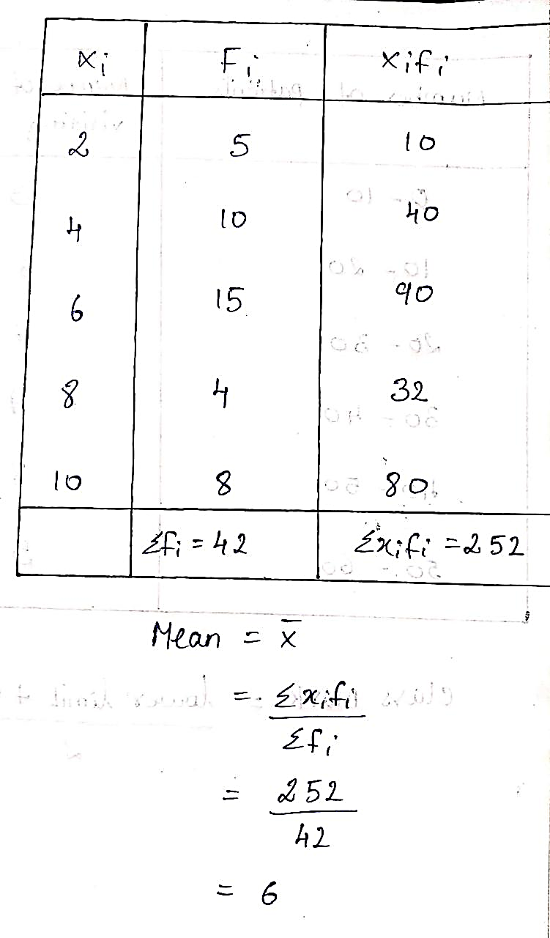
mean: Numericals
Determine the mean value for the following distribution

Slide 29
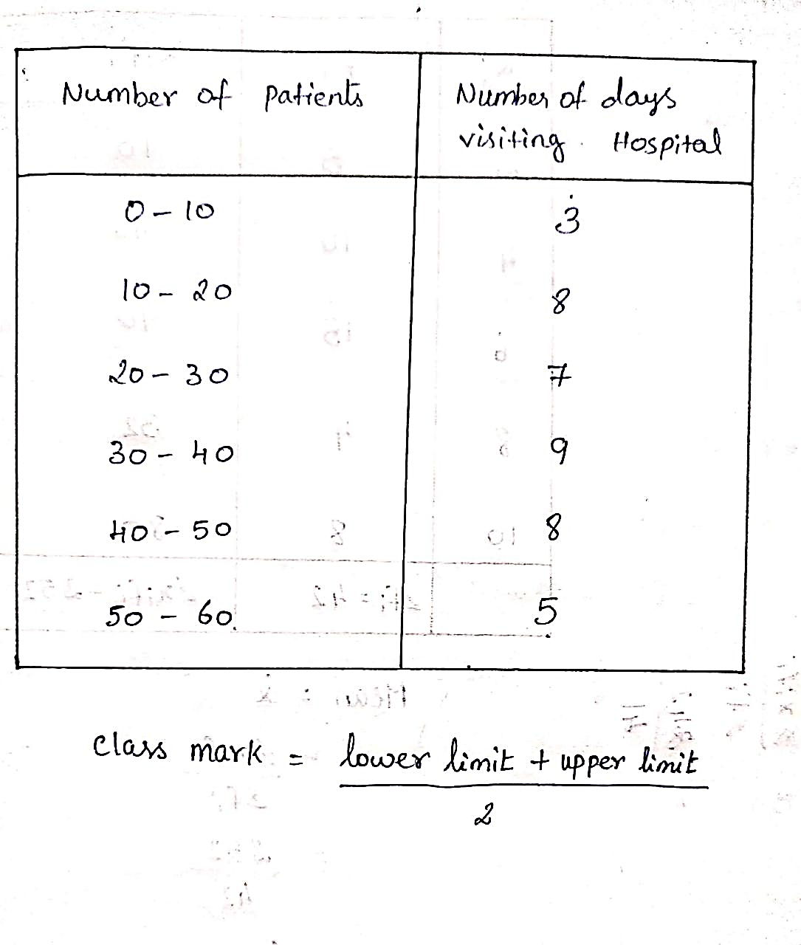
mean: Numerical
Data is in the form of Interval data:
Determine the average number of patients visiting per day

Slide 30
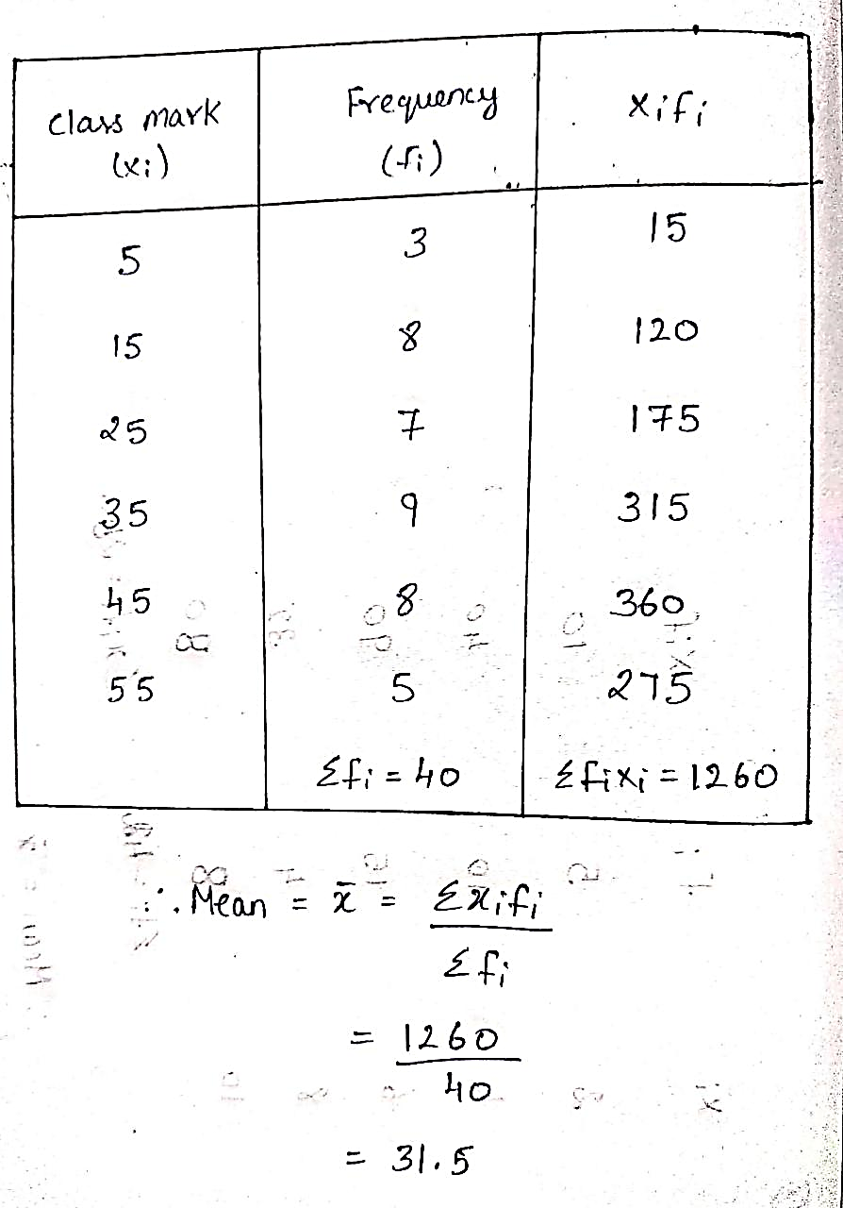
Mean: Numerical

Slide 31
Descriptive statistics
Median:
The median is the middle value in a data set. As you might guess, in order to calculate the middle, you need:
– first listing the data in a numerical order – second, locating the value in the middle of the list

Slide 32
Median:
A useful statistic due to its robustness .
It can reduce the effect of outliers.
Often used when the data is nonsymmetrical.

Slide 33
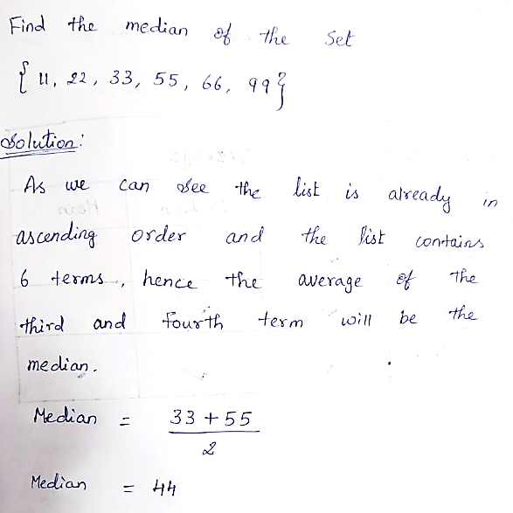
Example for median: Note: If the number of observation is odd ,the number in the middle of the list is the median. Else, If the number of observation is even ,then the median is the simple average of the middle two numbers.

Slide 34
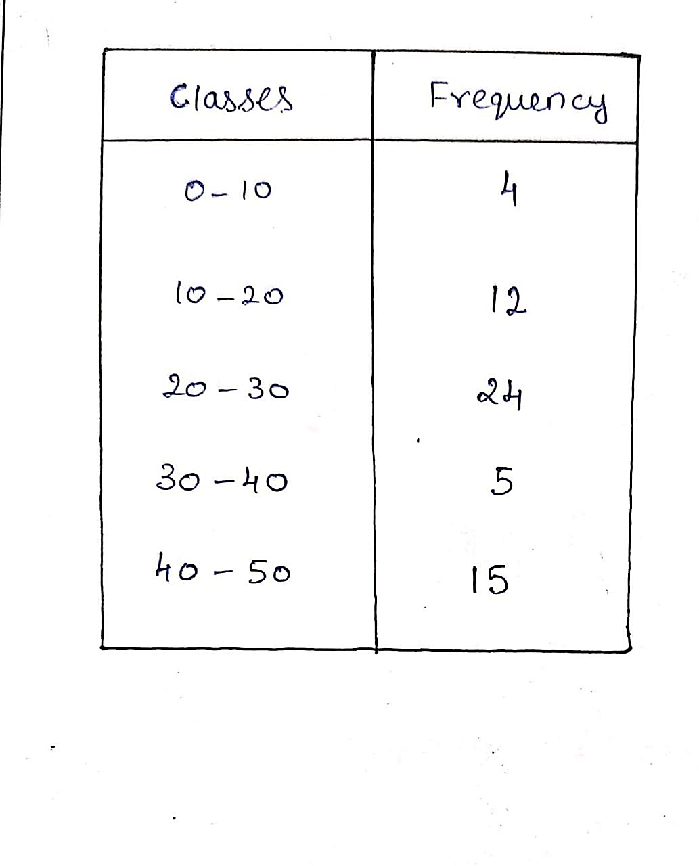
Median: Numerical
Determine the Median Value for the following distribution

Slide 35
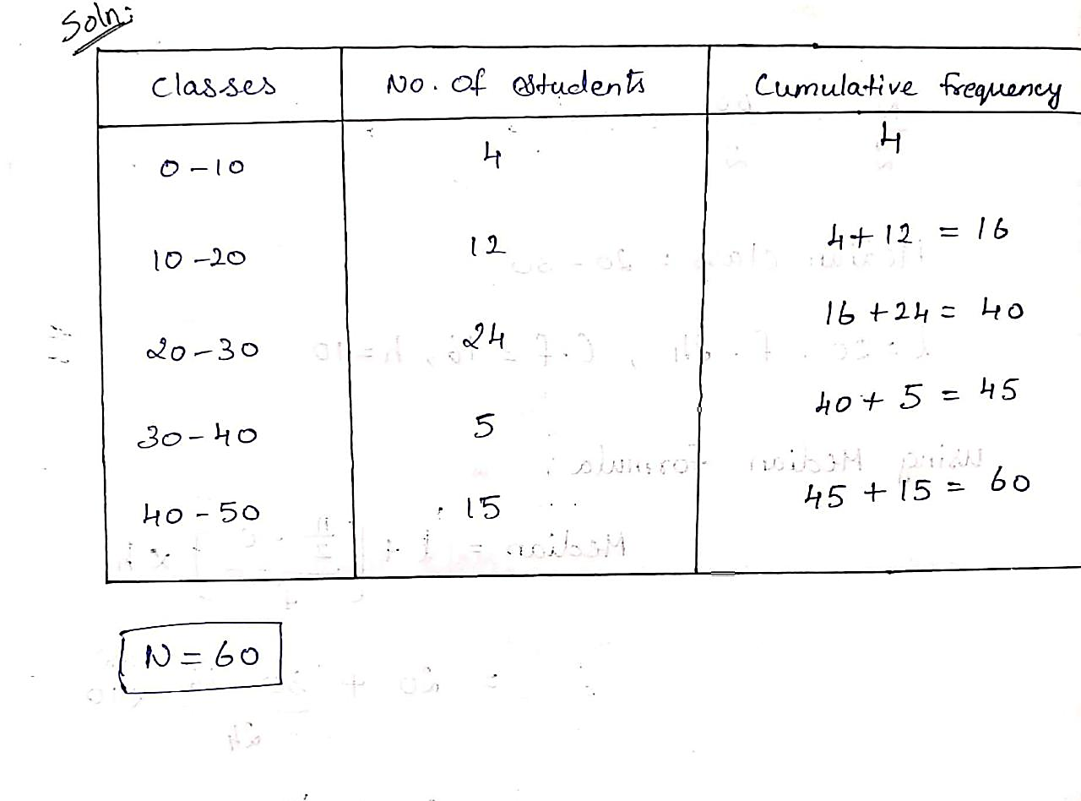
Median: Numericals
Determine the Median Value for the following distribution

Slide 36
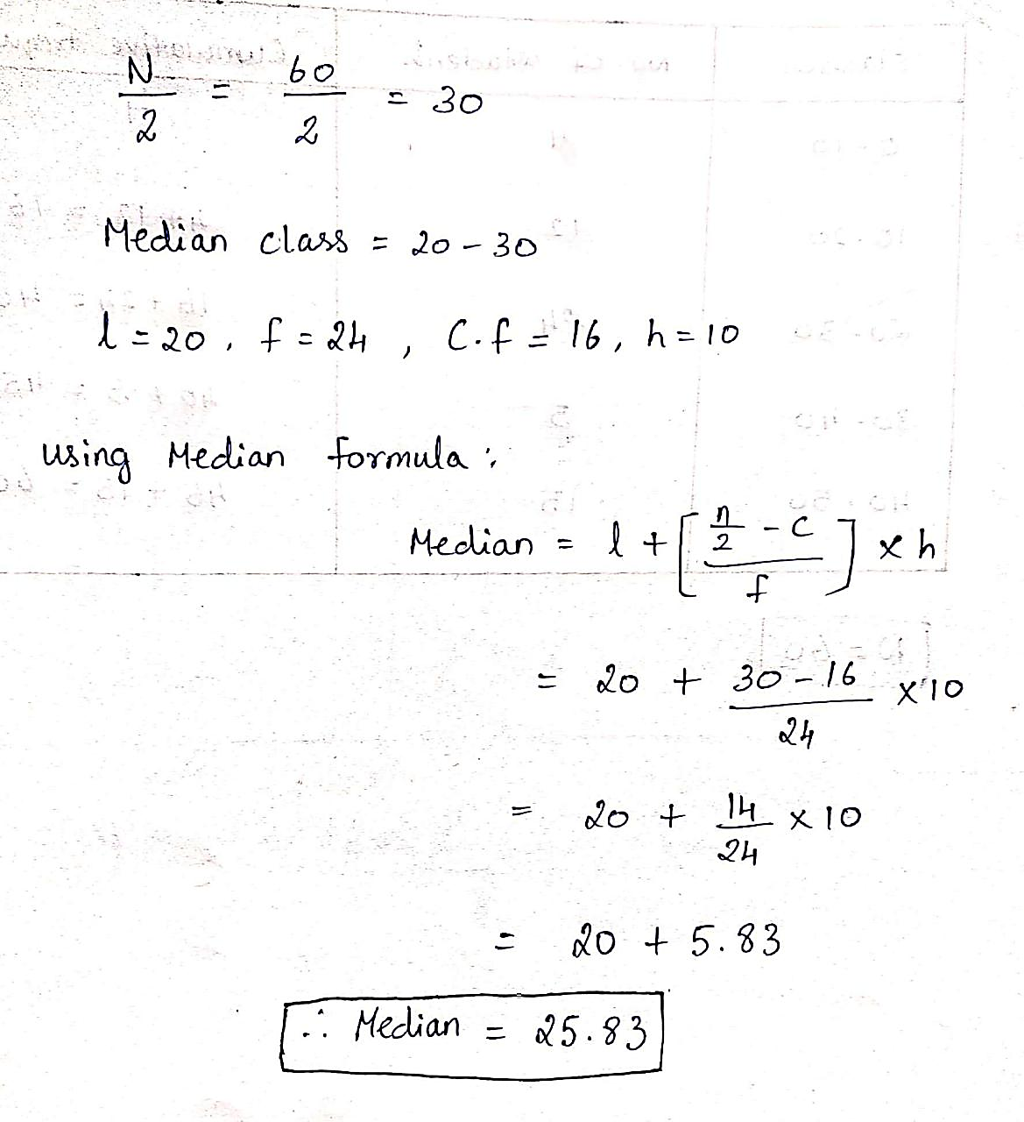
Median: Numericals

Slide 37
Mode:
Mode
The value that occurs the most often in a data set.
It is rarely used as a central tendency measure
It is more useful to distinguish between unimodal and multimodal distributions.

Slide 38
The difference between the mode, mean, and median
Here are some hints:
The word Mode is very like Most (the most frequent number)
“Mean” requires you do some arithmetic (adding all the numbers together and dividing).

Slide 39
The difference between the mode, mean, and median
Here are some hints:
“Median” practically means “Middle” and has the same number of letters.
Eg:
It is used with categorial data such as most sold T-shirts size.

Slide 40
Example for mode
Consider the following number distribution of 2, 3, 6, 3, 7, 5, 1, 2, 3, 9.
The mode of these numbers would be 3 since three is the most frequently occurring number. In cases where you have a very large number of scores, creating a frequency distribution can be helpful in determining the mode.

Slide 41
Numerical
Find the mode of the following:
List A = {1,2,3,3,4,4,5,6}
Mode [A] = {3,4}
List B = {1,2,3,3,4,4,5,5,6}
Mode [B] = {3,4,5}
Bi modal List
Tri modal List

Slide 42
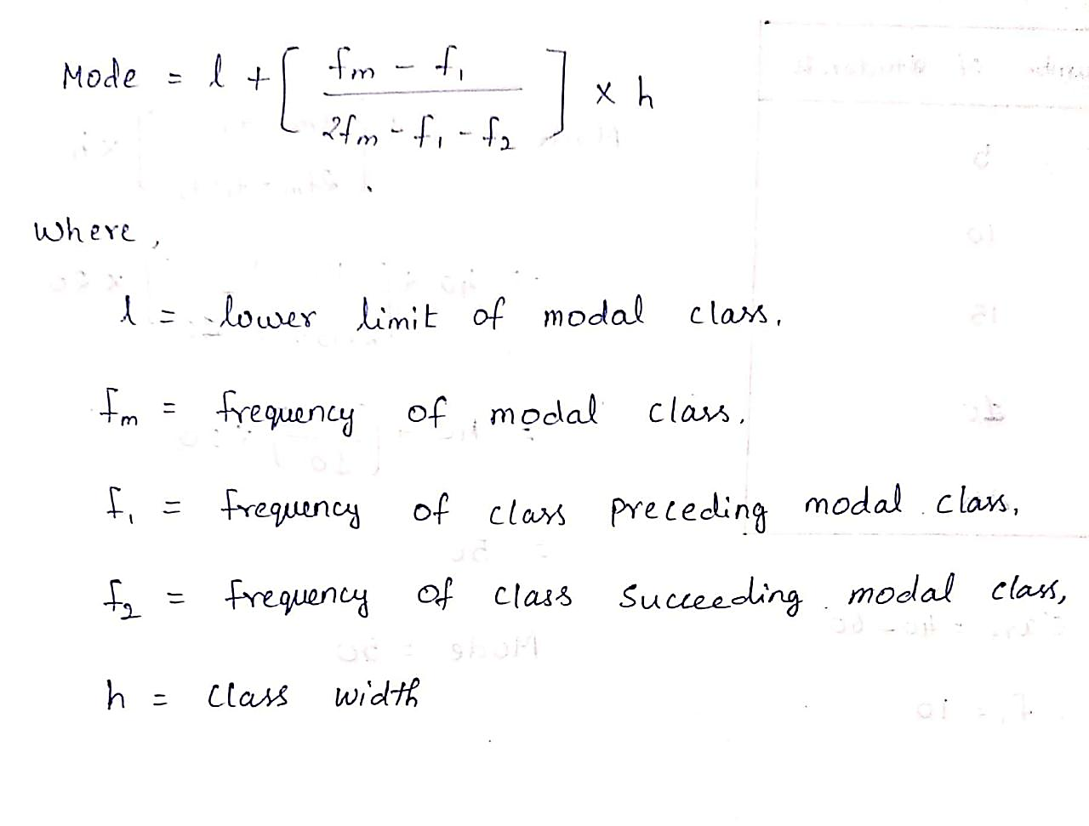
Continuous Data

Slide 43
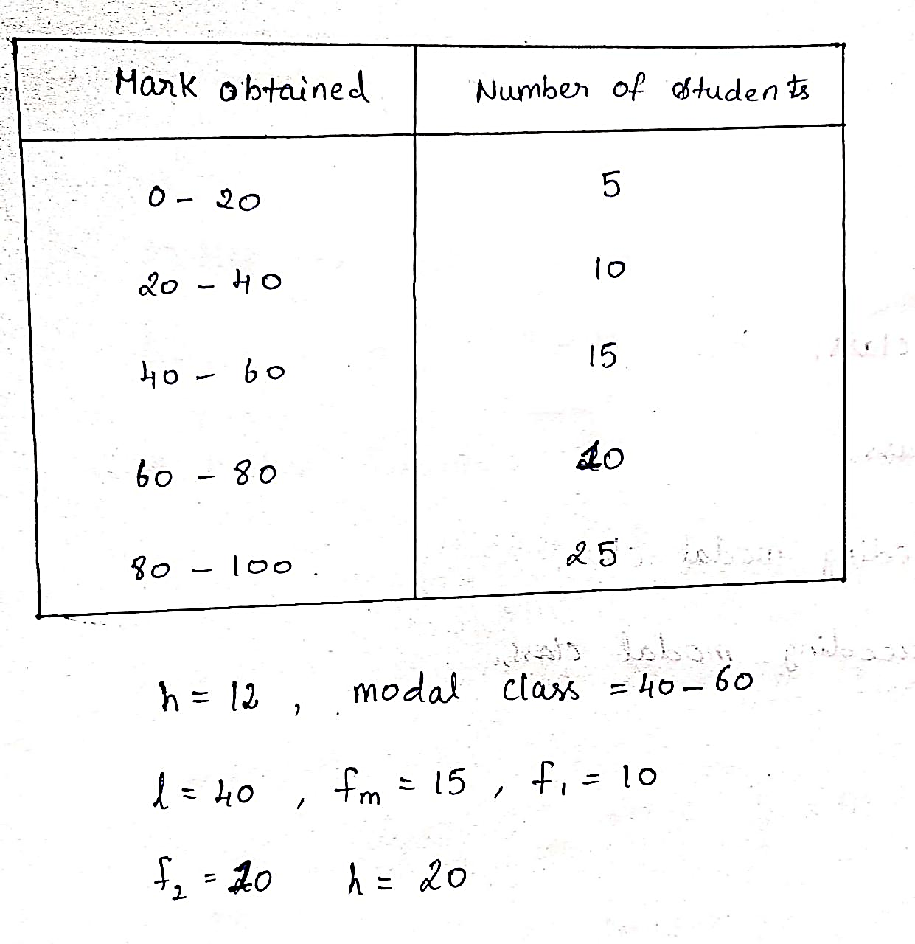
Continuous Data
Find the mode of the given data

Slide 44
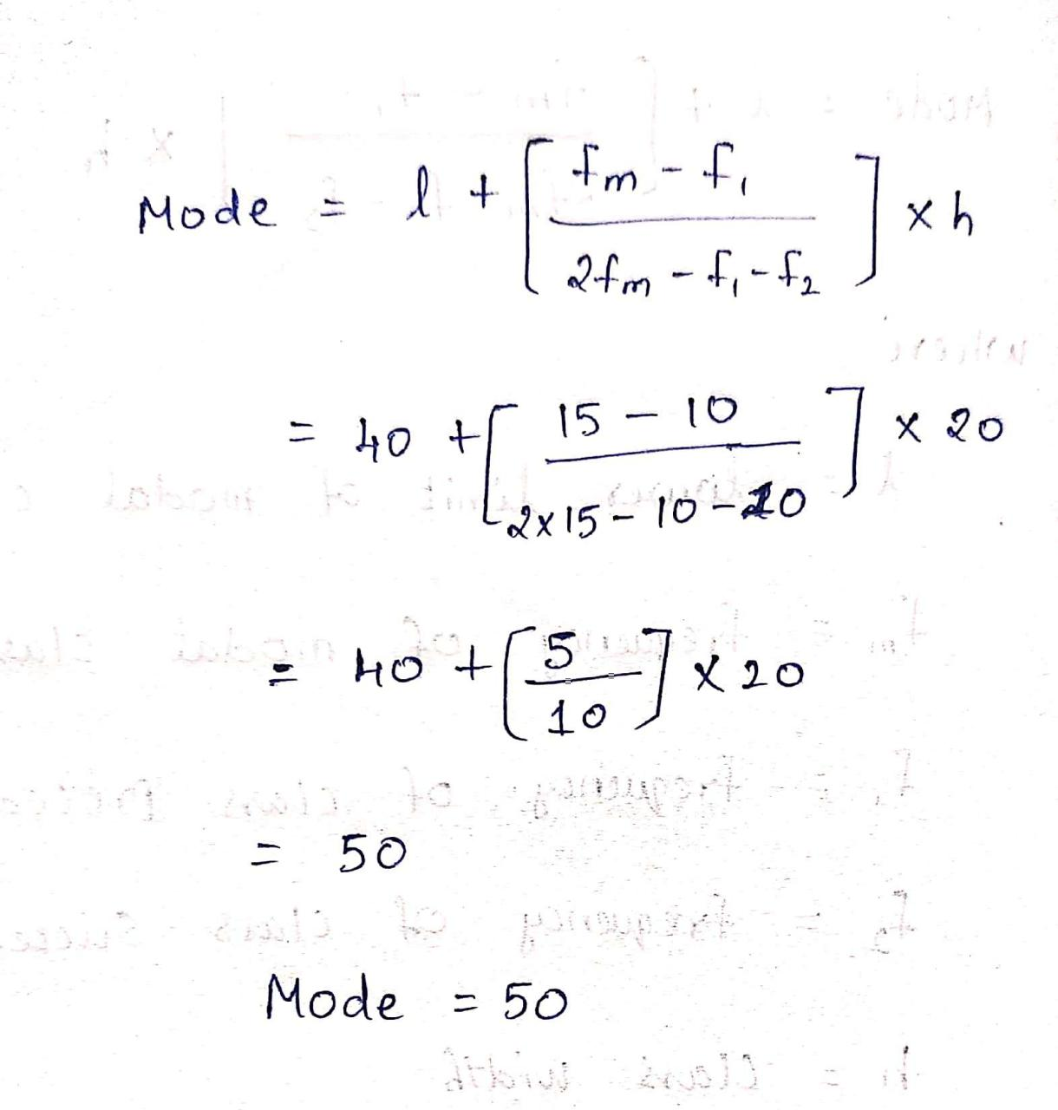
Continuous Data
Find the mode of the given data

Slide 45
Relation between the mode, mean, and median
2Mean + Mode =3Median
This is called as an Emperical relationship
If mode = 65 and median = 61.6 , Find Mean
2Mean + Mode =3Median
2 Mean = 3 x 61.6 – 65
2 Mean = 119.8
Mean = 119.8
2
Mean = 59.9

Slide 46
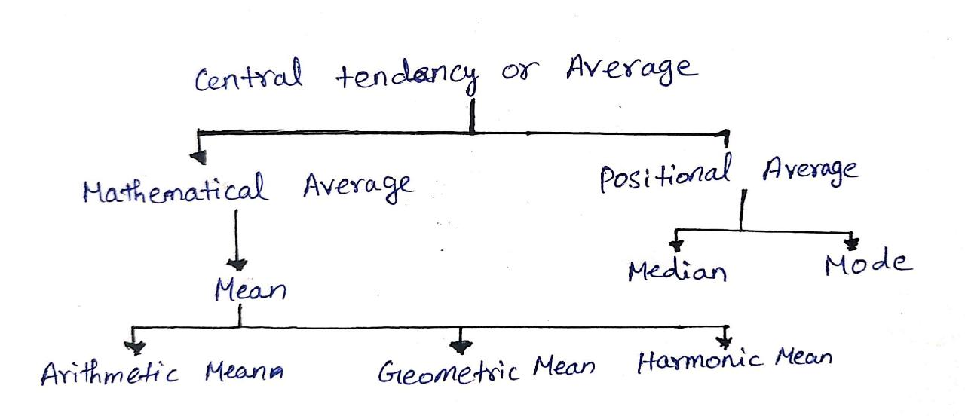
Mean is called as the mathematical average whereas median and mode are positional averages.

Slide 47
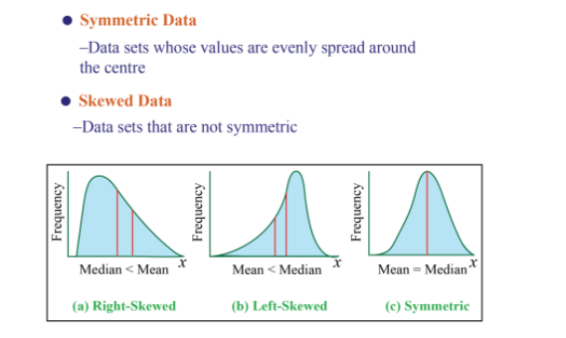

Slide 48

A shoe manufacturer is planning for his next year’s production. He needs to decide which shoe size is to be manufactured in large numbers. Which of the following measures of central tendencies would he consider for this?
Answer : Median & Mode

Slide 49
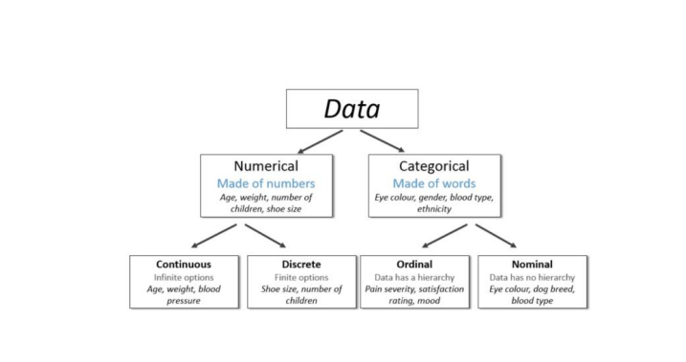
Types of data
Data is broadly classified into 3 categories
Numerical data
Categorical data
Ordinal data –amalgamation of numerical and categorical data

Slide 50
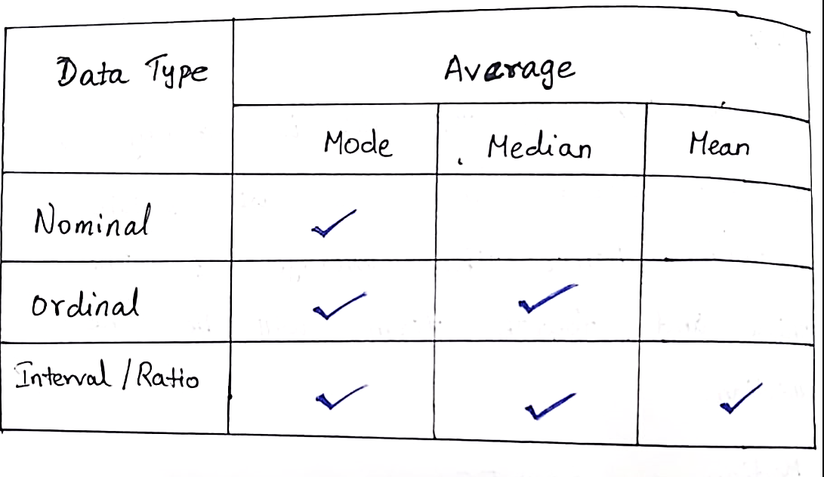
which measure to use when you have nominal, ordinal or interval data

Slide 51
Measures of spread: The spread refers to how the data deviates from the position measure. There are different statistics by which we can describe the spread of a data set: - Range - Standard deviation

Slide 52
Range
The difference between the highest and the lowest values.
The simplest measure of variability.
Often denoted by ‘R’.
It is most useful in representing the dispersion of small data sets.
It can be misleading when the data is skewed or in the presence of outliers.

Slide 53
Range:
Problem: You take 7 statistics tests over the course of a semester. You score 94, 88, 73, 84, 91, 87, and 79. What is the range of your scores?
Solution:
Step 1: Order your scores from smallest to largest:73, 79, 84, 87, 88, 91, 94.
Step 2: Subtract the smallest number from the highest = 94 – 73 = 21.
Answer: 21.

Slide 54
Interquartile range
The interquartile range also called the midspread
It will be dividing data set into quartiles.
Quartiles will be divided into four equal parts.
The separated parts will be denoted by Q1,Q2 and Q3.
ML LABS PVT LTD || WWW.ANALYTICS6.COM || DATA SCIENCE , AI , ML ,COMPUTER VISION || TRAINING AND CONSULTING
Phone Number : 91-6362546088 || Email : contact@analytics6.com

Slide 55
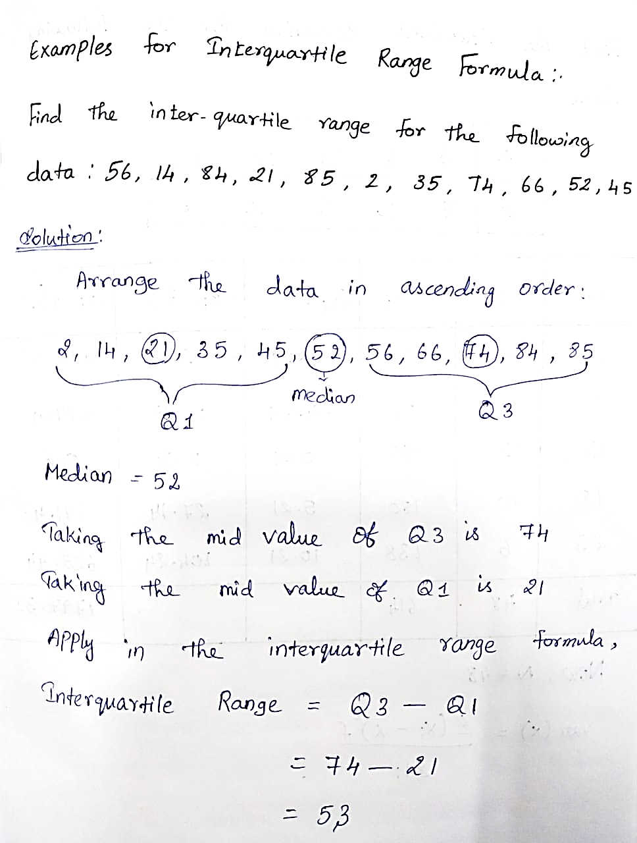

Slide 56
Variance > Variance is the average squared deviation from the mean of a set of data. > It is used to find the standard deviation.

Slide 57
To Find Variance > Find the Mean of the data - mean is the average so add up the values and divide by the number of items

Slide 58
To Find Variance > Subtract the Mean from each value – the result is called the deviation from the mean. > Square each deviation of the mean. > Find the sum of the squares. > Divide the total by the number of items.

Slide 59
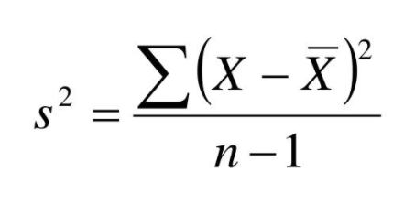
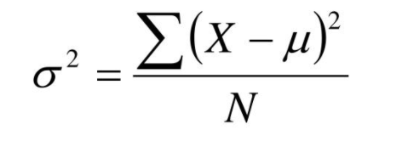
Variance Formula
For population variance For Sample variance Mean is represented by μ and x̄ and n and N is the number of items.

Slide 60
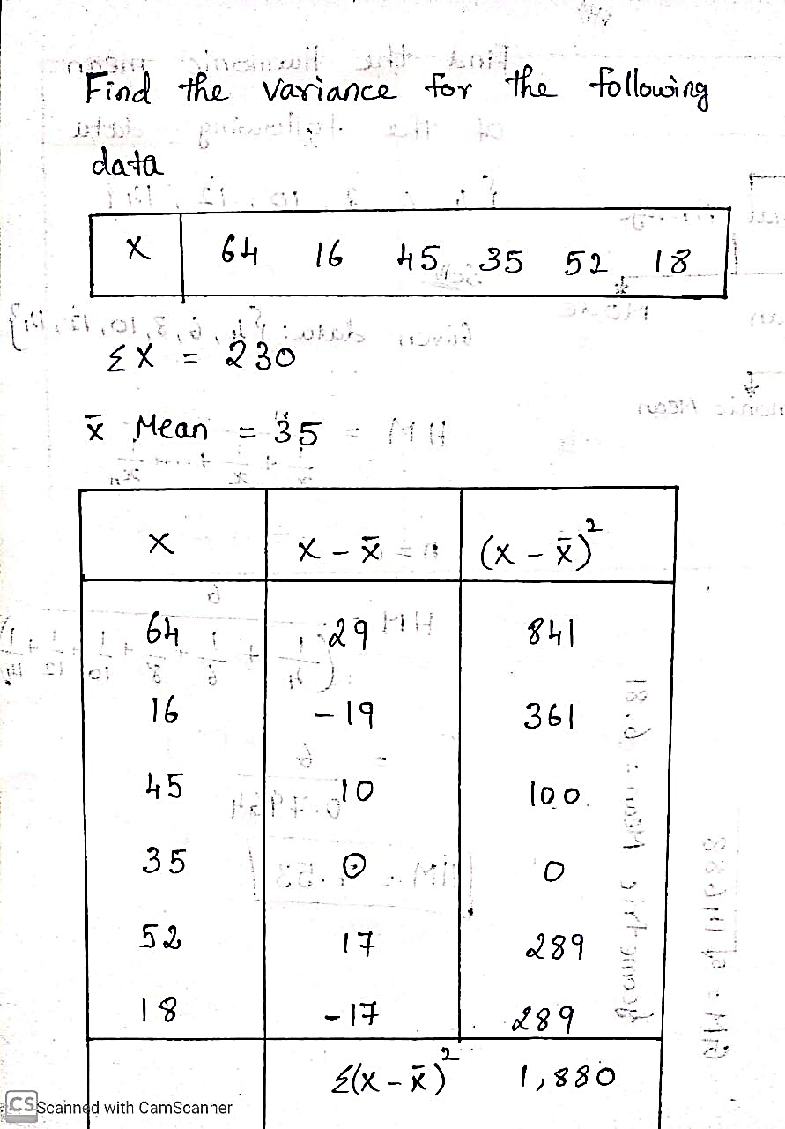
Variance Numerical

Slide 61
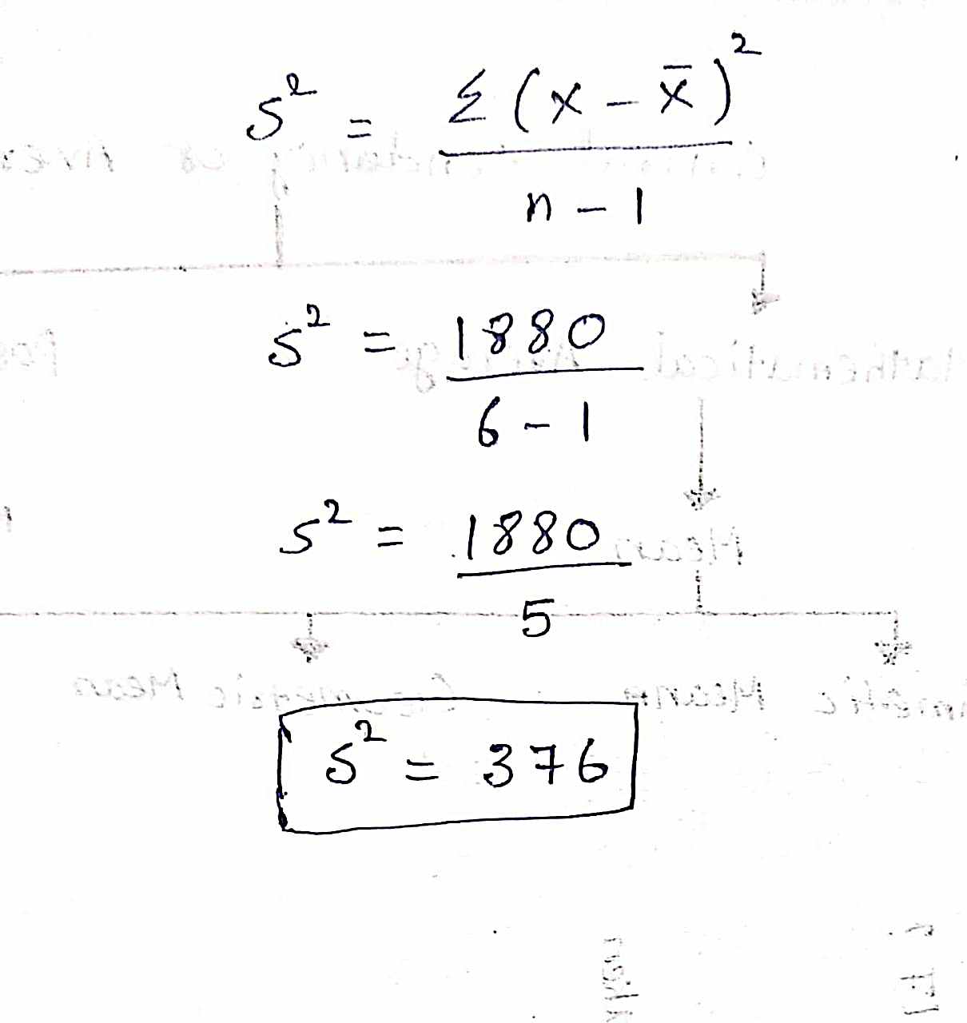
Variance Numerical

Slide 62
coefficient of Variance
It is the ratio of the standard deviation to the mean.
It is also known as relative standard deviation.
It is often expressed as percentage.

Slide 63
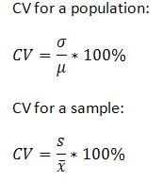
coefficient of Variance Formula

Slide 64
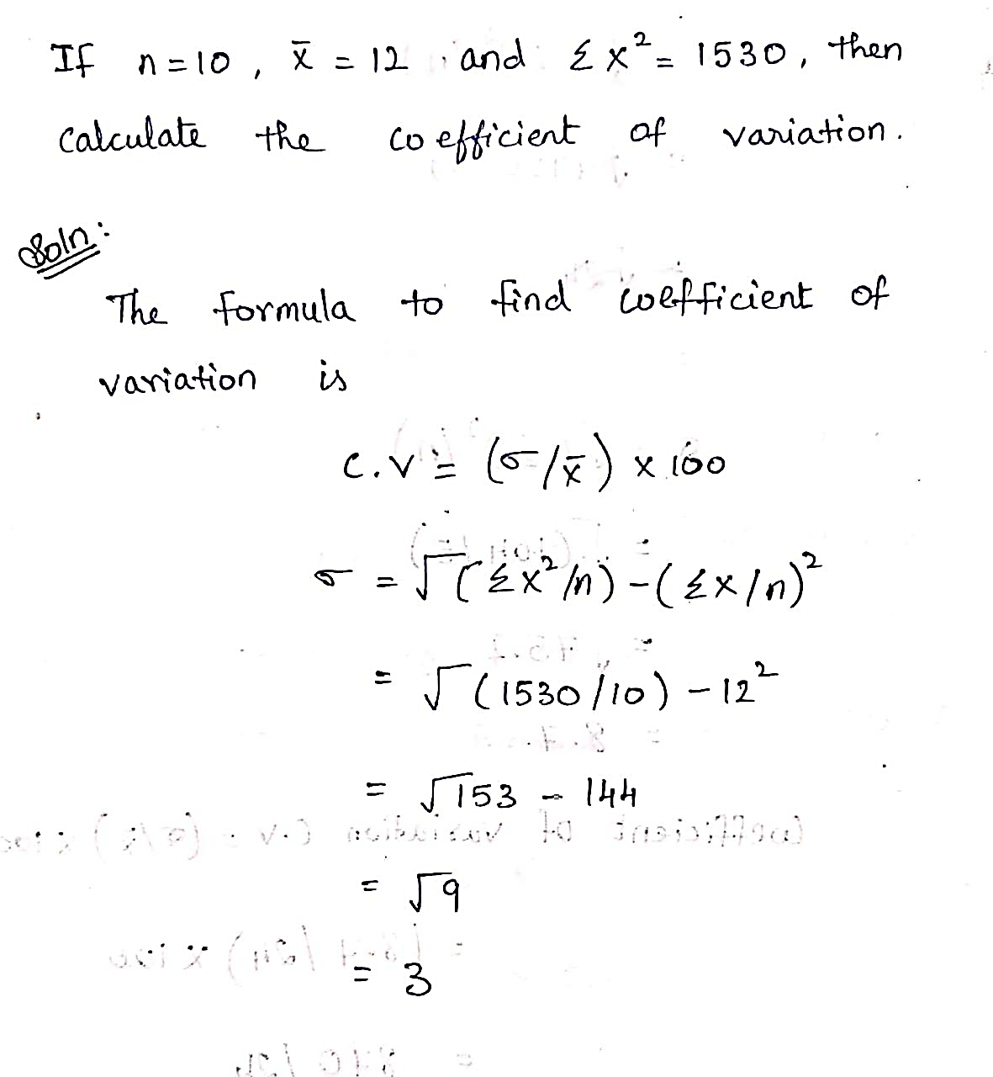
Coefficient of Variance Numerical

Slide 65
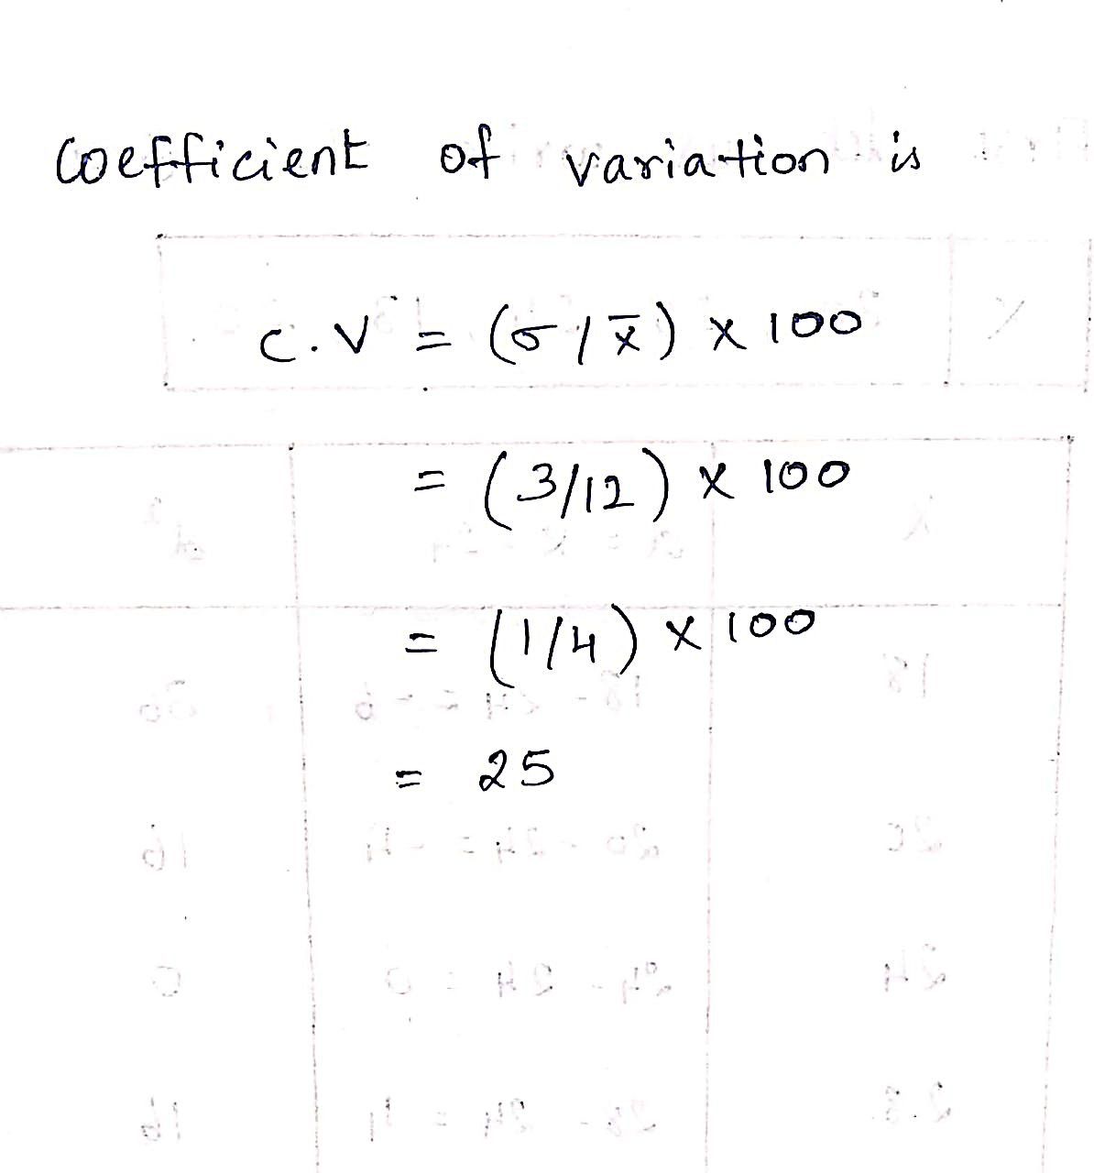
coefficient of Variance Numerical

Slide 66
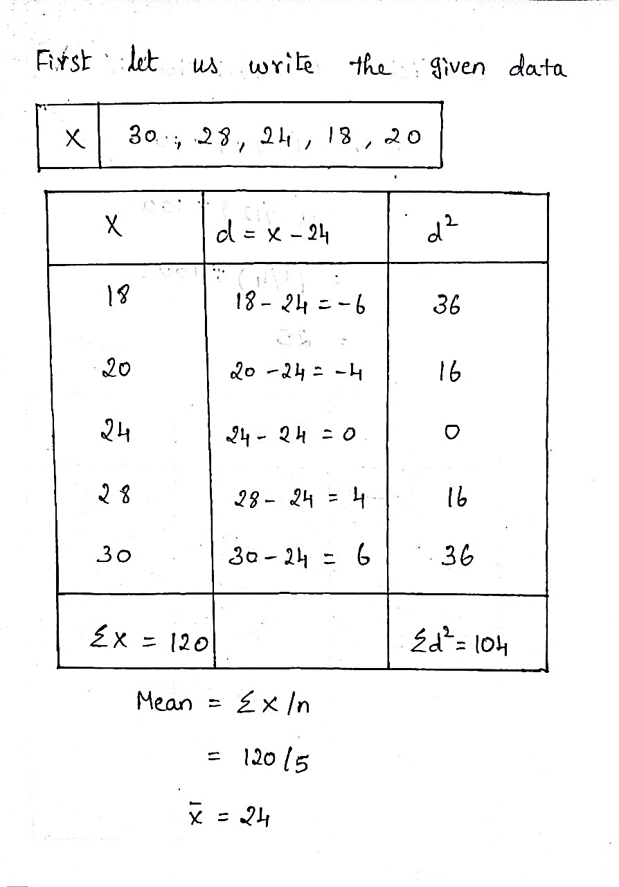
coefficient of Variance Numerical

Slide 67
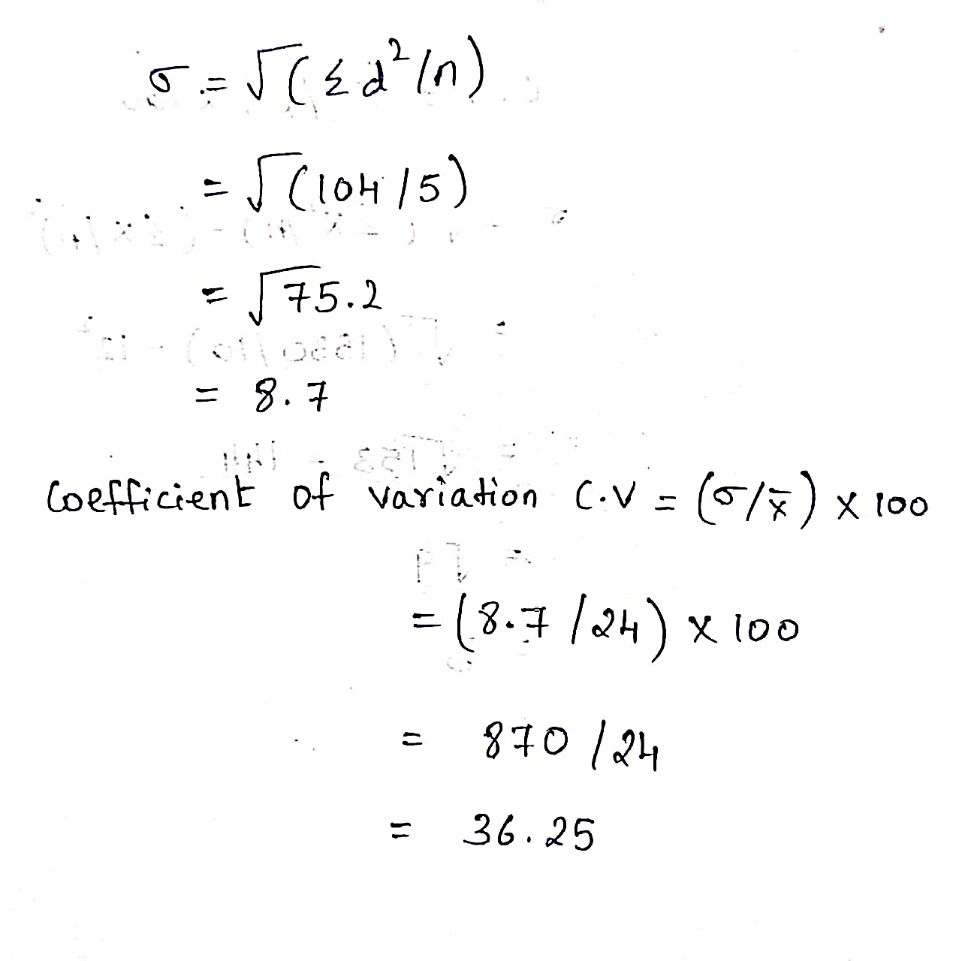
coefficient of Variance Numerical

Slide 68
Percentile:
The most common definition of a percentile is a number where a certain percentage of scores fall below that percentile.

Slide 69
Percentile:
• Percentiles are used to understand and interpret data. They indicate the values below which a certain percentage of the data in a data set is found. • Percentiles can be calculated using the formula n = (P/100) x N, where P = percentile, N = number of values in a data set (sorted from smallest to largest), and n = ordinal rank of a given value.

Slide 70
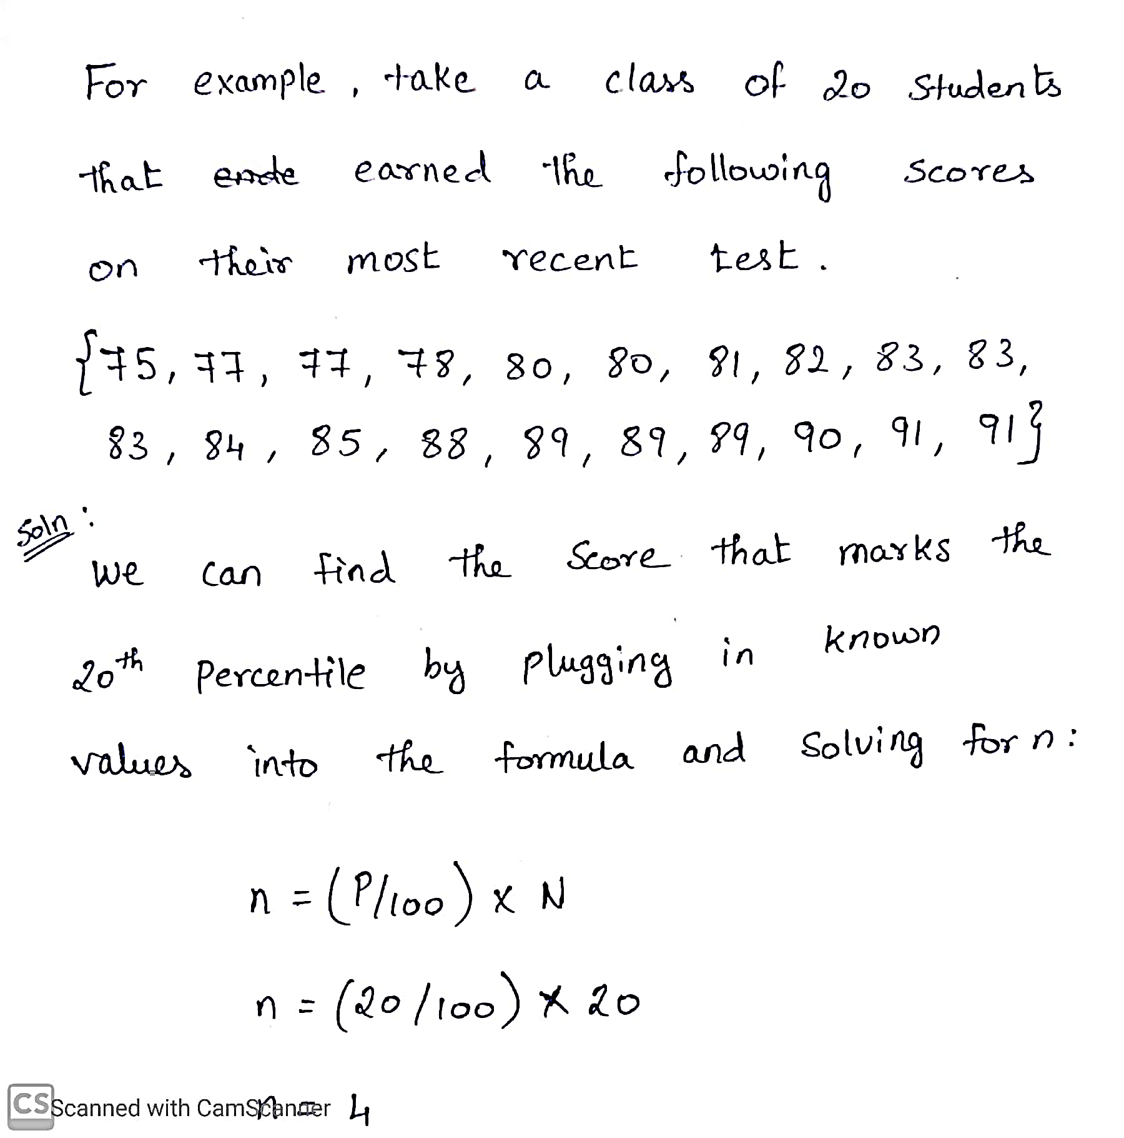
Percentile Numerical

Slide 71
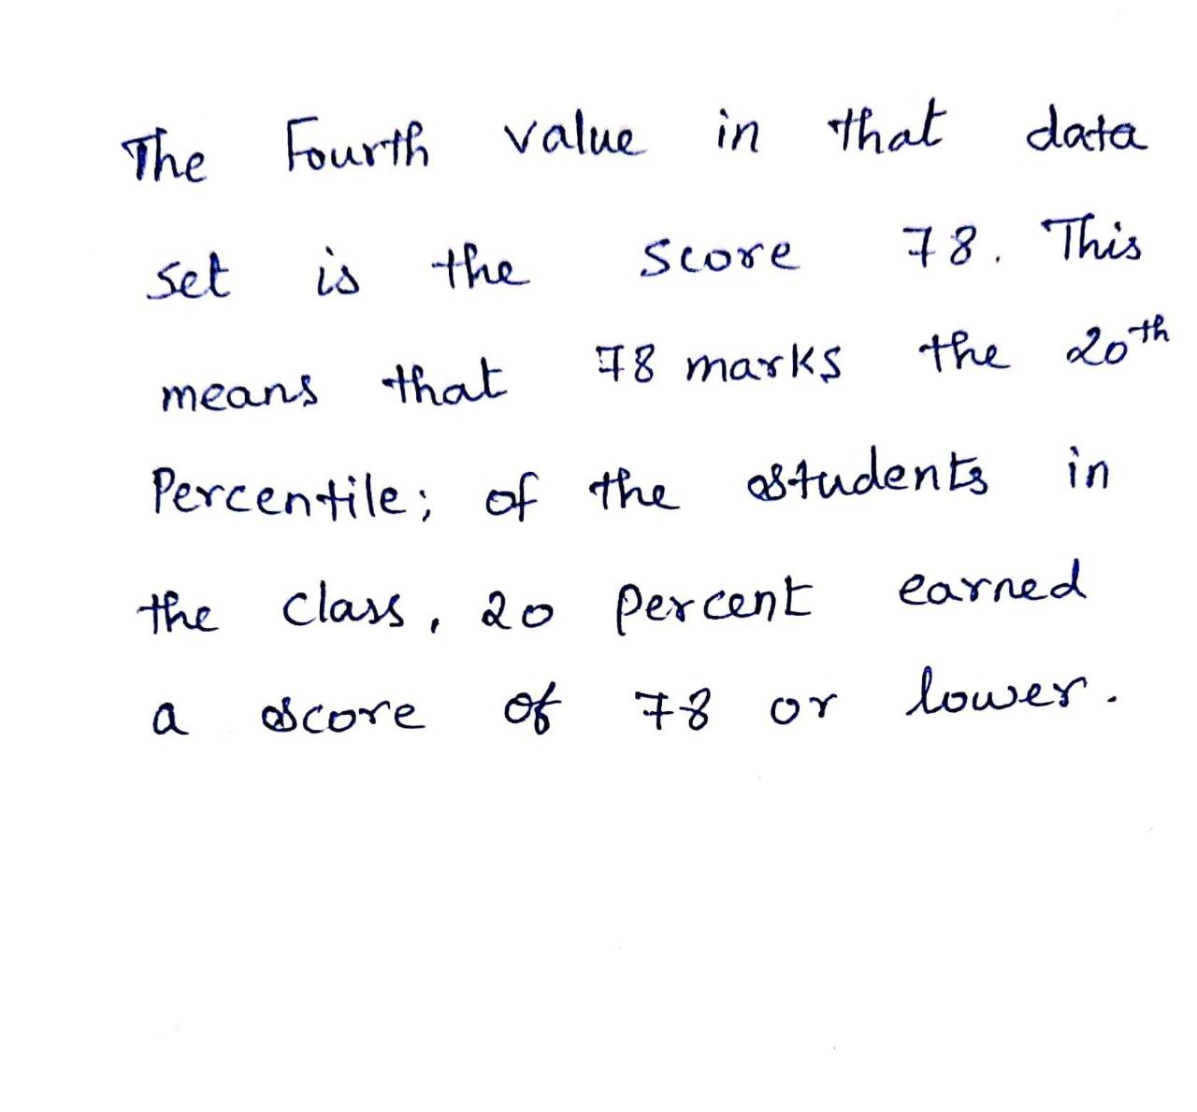
Percentile Numerical

Slide 72
Standard deviation
The average distance of the data points from their own mean.
Standard deviations are usually easier to picture and apply.
The biggest drawback of using standard deviation is that it can be impacted by outliers and extreme values.

Slide 73
Standard deviation
A low standard deviation indicates that the data points are clustered around the mean.
A high standard deviation indicates that they are widely scattered around the mean.

Slide 74
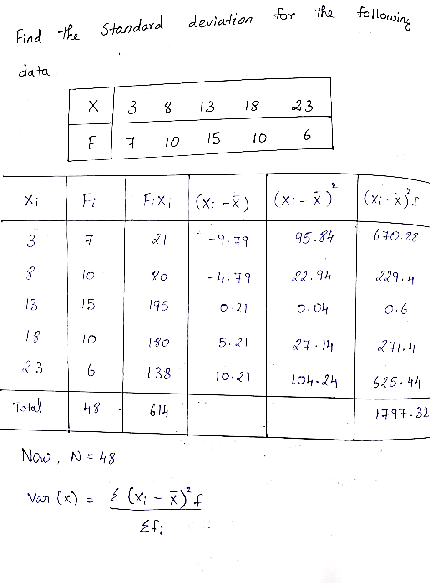
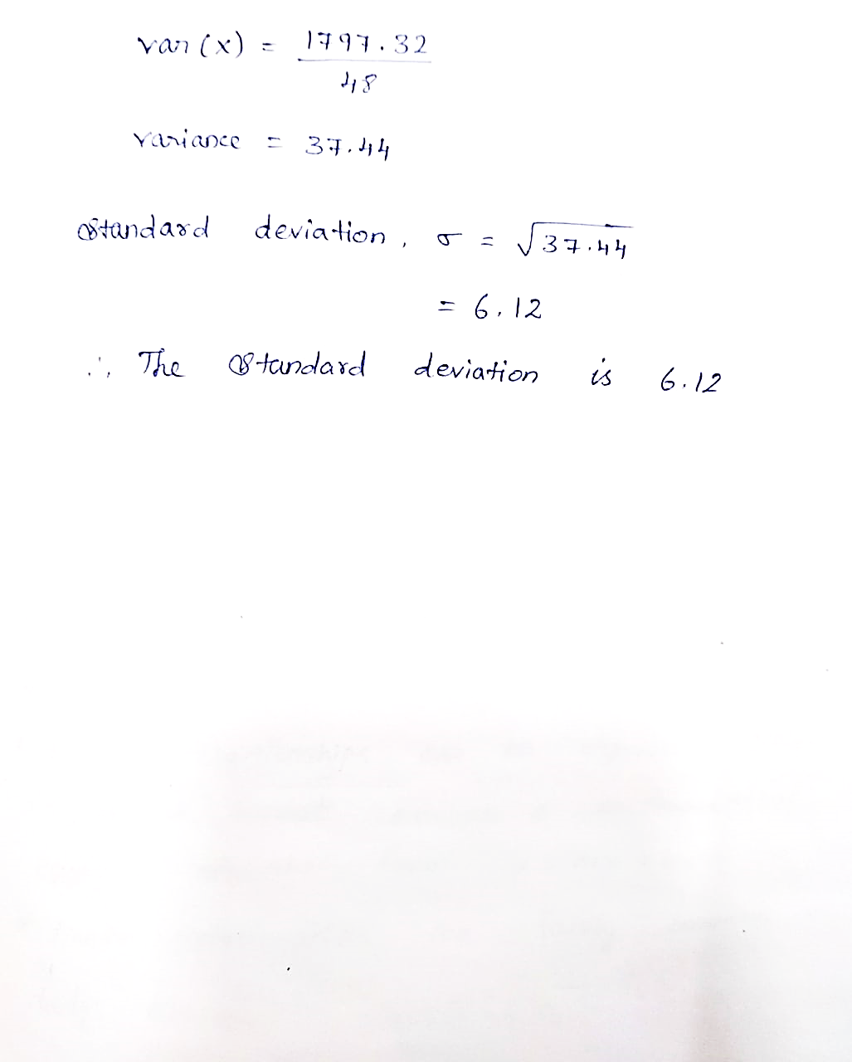

Slide 75
Measure of shape
Data can be plotted into a histogram to have a general idea of its shape or distribution.
The shape can reveal a lot of information about the data.
Two common statistics that measure the shape of the data.
-skewness
-kurtosis

Slide 76
1 Moments
Moments
Moments in mathematical statistics involve a basic calculation. These calculations can be used to find a probability distribution's mean, variance, and skewness.

Slide 77
1 Moments
Moments
For the first moment, we set s = 1. The formula for the first moment is thus: (x₁x₂ + x₃ + ... + x_{n})/n
This is identical to the formula for the sample mean.
The first moment of the values 1, 3, 6, 10 is (1 + 3 + 6 + 10) / 4 = 20/4 = 5.

Slide 78
1 Moments
Moments
Moments are a set of statistical parameters to measure a distribution. Four moments are commonly used:
• 1st moment - Mean (describes central value)
• 2nd moment - Variance (describes dispersion)
• 3rd moment - Skewness (describes asymmetry)
• 4th moment - Kurtosis (describes peakedness)

Slide 79
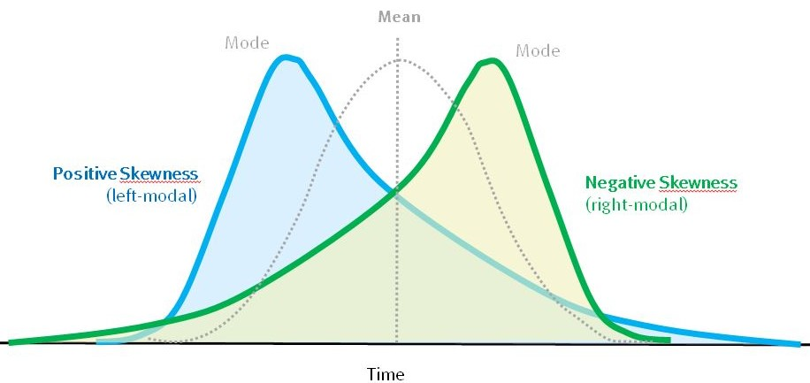
skewness
skewness is a measure of the asymmetry of the probability distribution of a real-valued random variable about its mean.
A skewness value of zero indicates perfect symmetry.
A negative value implies left skewed data.
A positive value implies right skewed data.

Slide 80
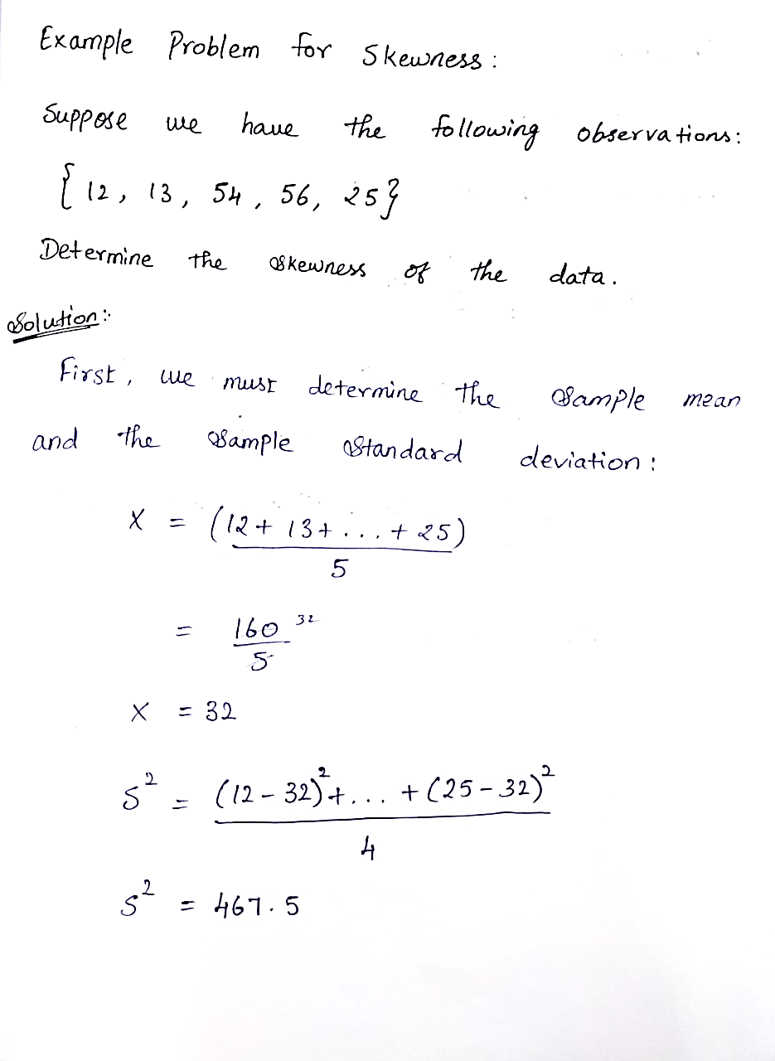
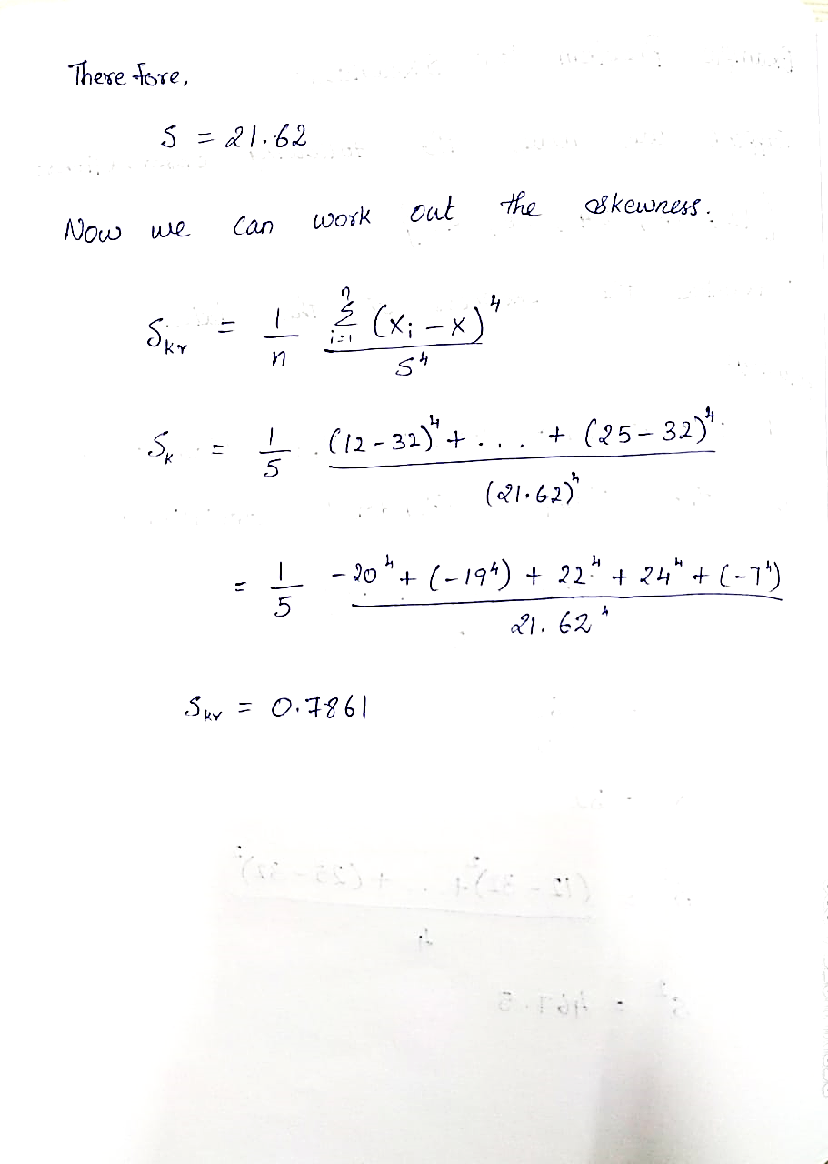
ML LABS PVT LTD || WWW.ANALYTICS6.COM || DATA SCIENCE , AI , ML ,COMPUTER VISION || TRAINING AND CONSULTING
Phone Number : 91-6362546088 || Email : contact@analytics6.com

Slide 81
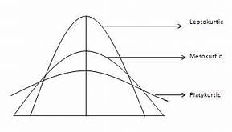
kurtosis
The degree of tailedness of a distribution is measured by kurtosis.
When the data values are clustered around the middle, then the distribution is more peaked.
When the data values are spread around more evently, then the distribution is more flattered.

Slide 82
Thank you

